Slide 1

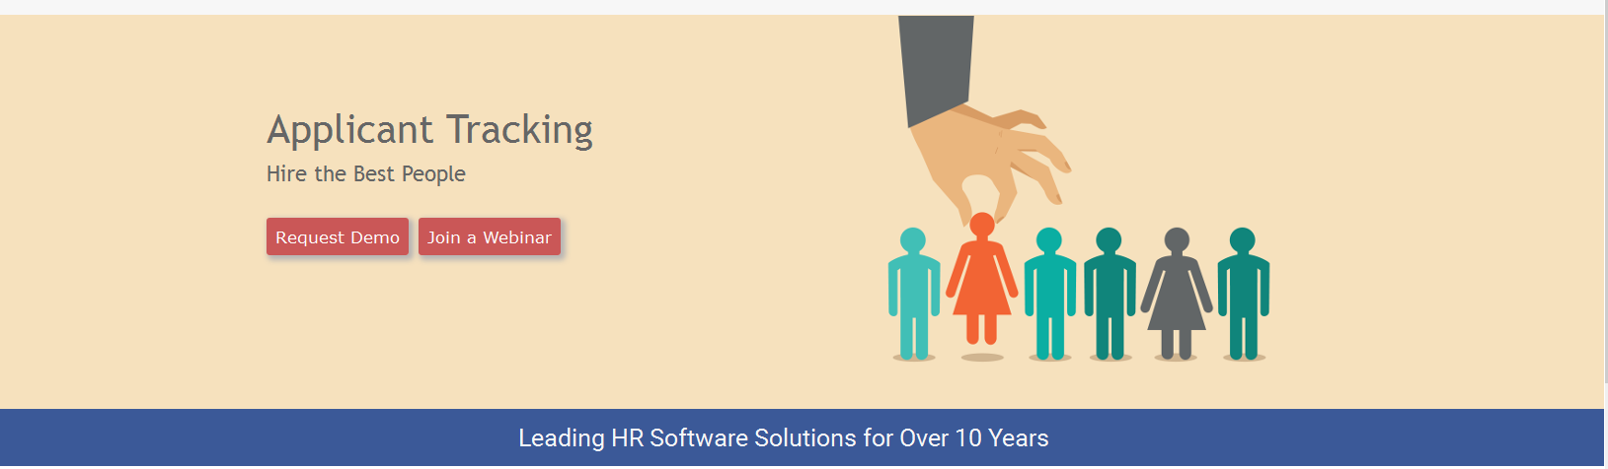
How to Create a Personnel Action Form (PAF)
Notes:
1

Slide 2
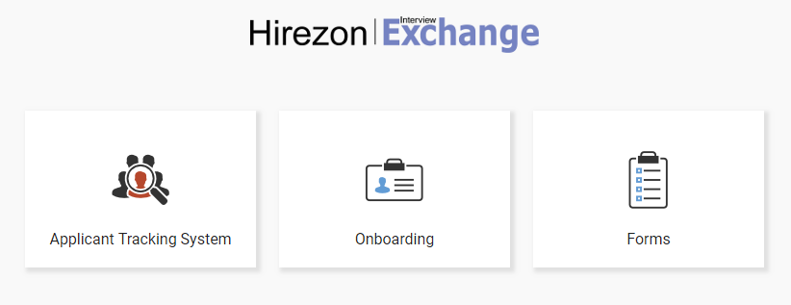
Click on ‘Forms’
Notes:
2

Slide 3
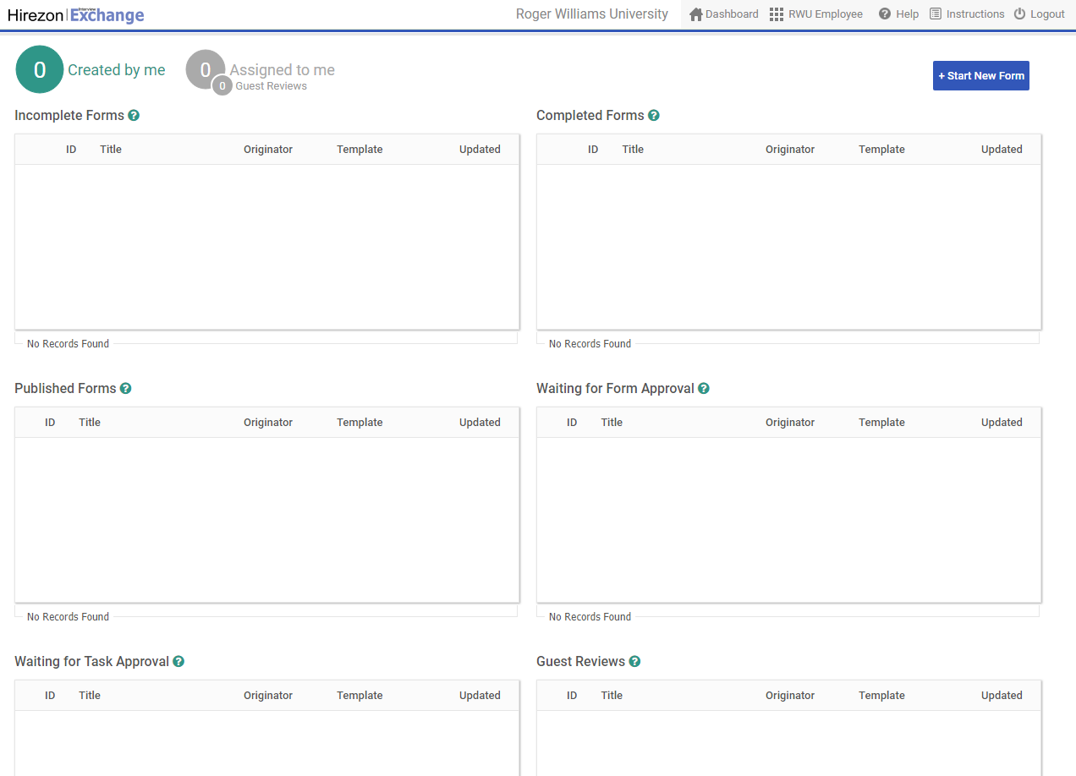
Employee View
Click on ‘Start New Form’

Slide 4
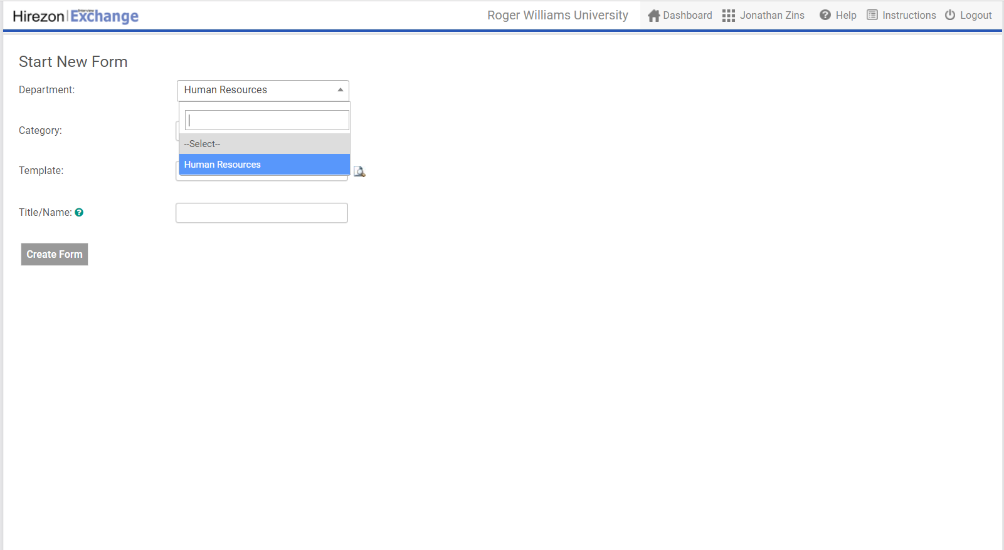
Click on ‘Department’, and select desired department
Notes:
4

Slide 5
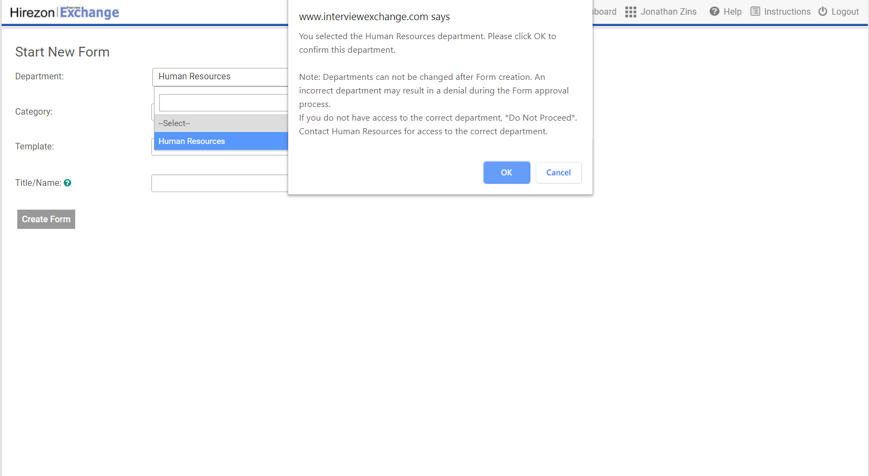
Click ‘Ok’
Notes:
5

Slide 6
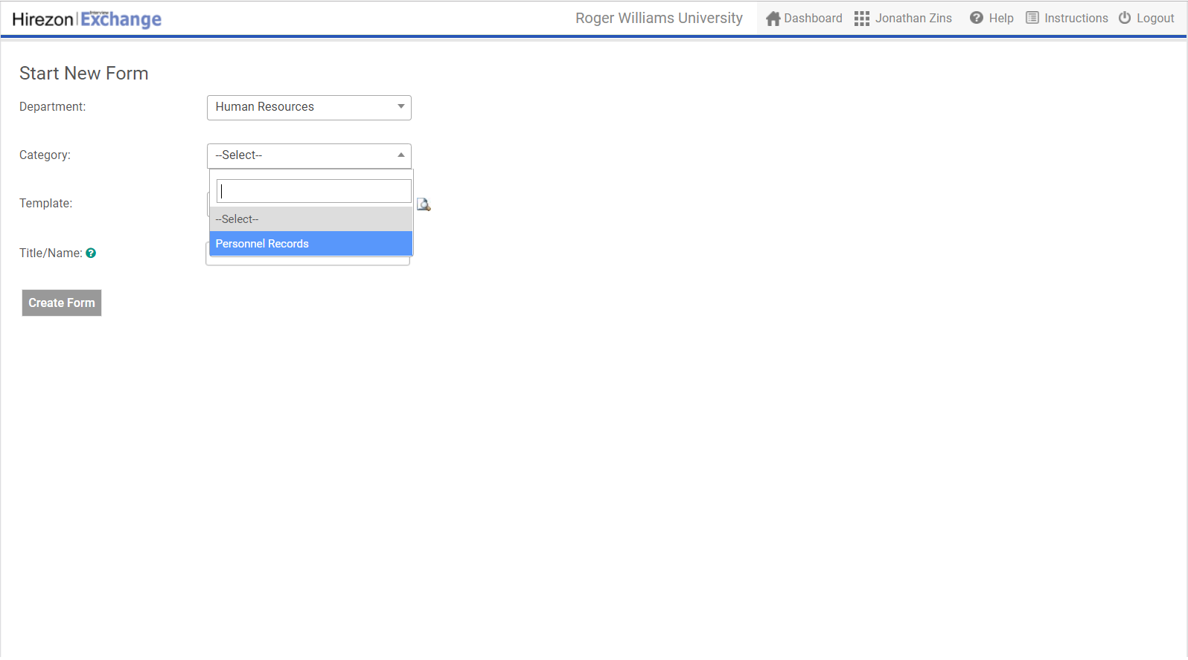
Click on ‘Category’, and select desired category
Notes:
6

Slide 7
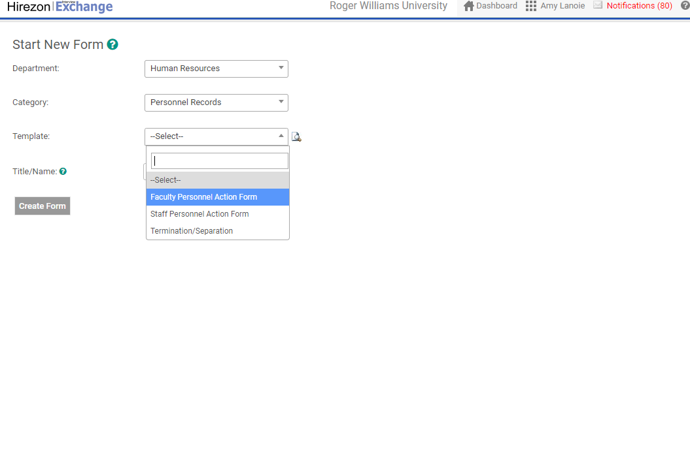
Click on ‘Template’, and select ‘Faculty Personnel Action Form’ or ‘Staff Personnel Action Form’
Notes:
7

Slide 8
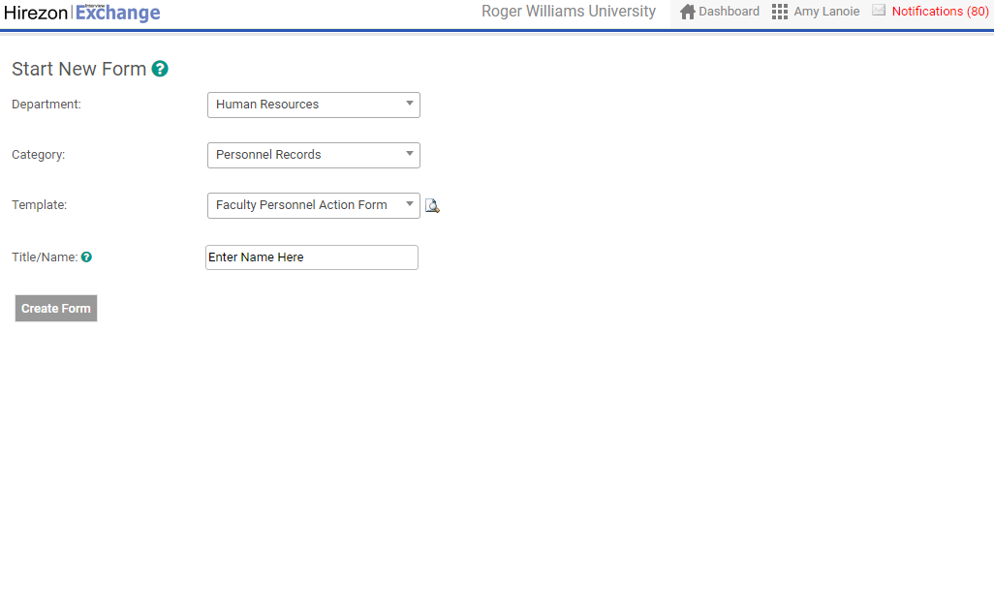
Enter Employee’s Name
Notes:
8

Slide 9
Click ‘Create Form’
Notes:
9

Slide 10
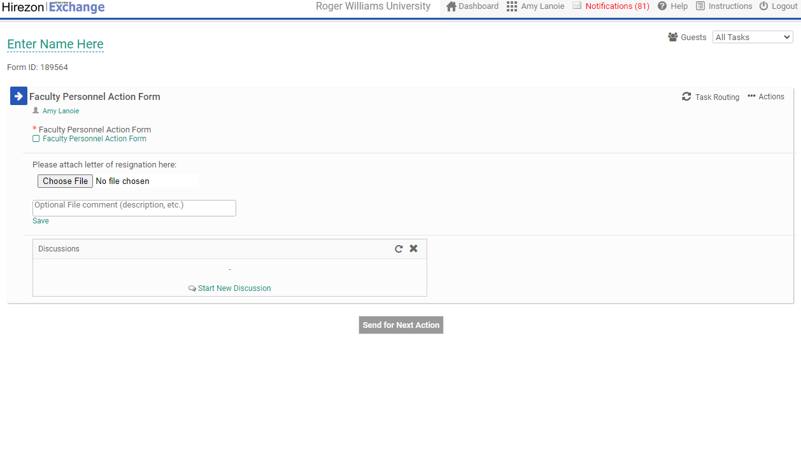
Click
‘Personnel Action Form’
Notes:
10

Slide 11
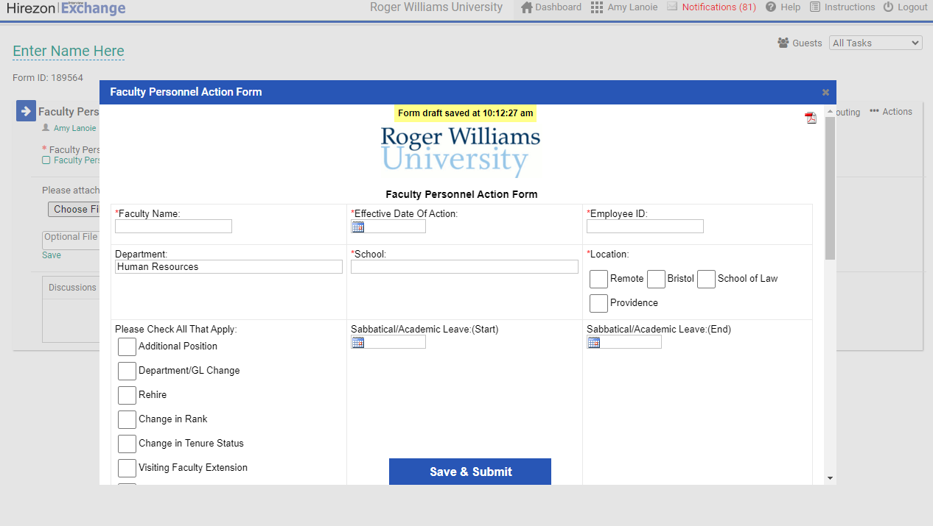
Complete form
Notes:
11

Slide 12
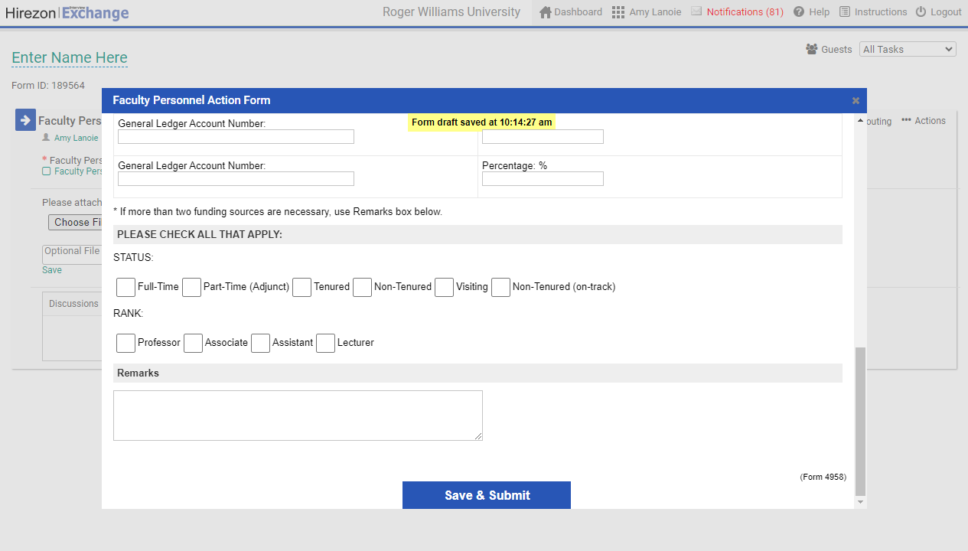
Click ‘Save & Submit’
Notes:
12

Slide 13
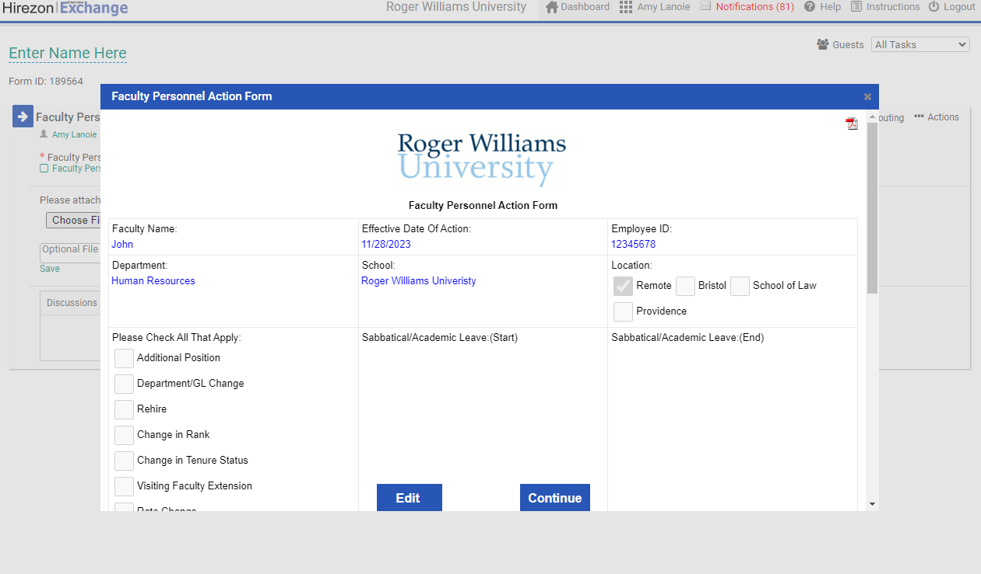
Click ‘Continue’
Notes:
13

Slide 14
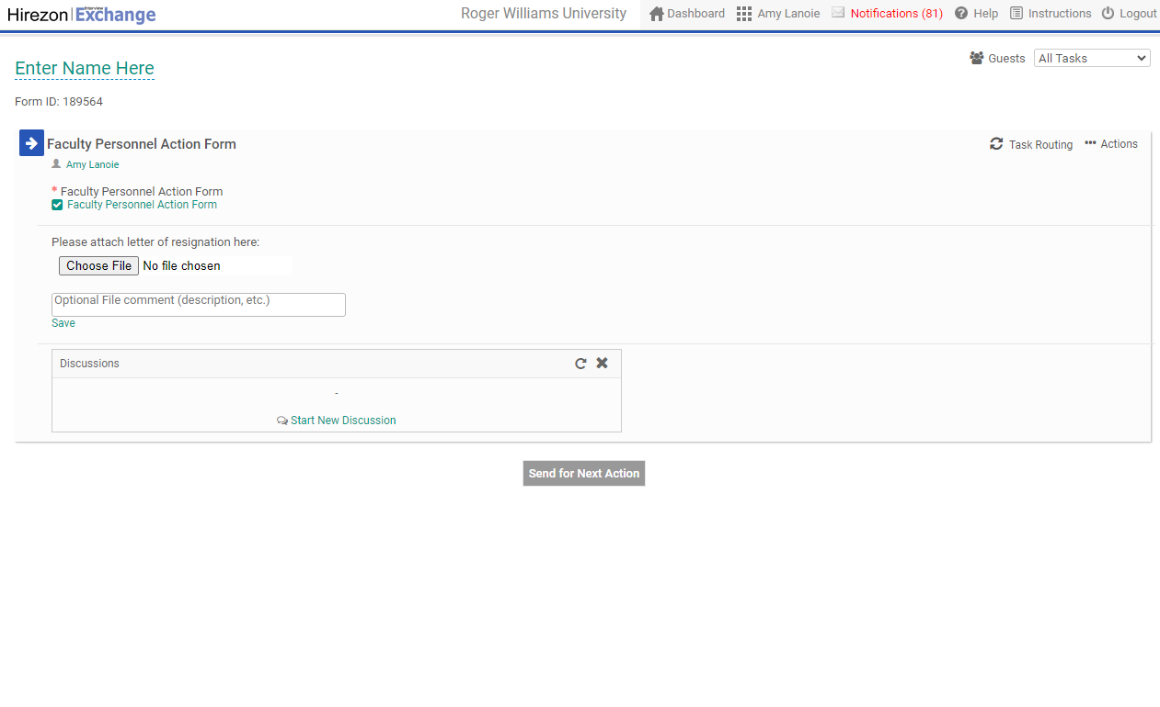
Click ‘Send for Next Action’
Notes:
14

